Slide 1
Semi-supervised Analysis of Media Attitudes toward Geopolitical Entities at the End of 2022
Hantao Hong, Jacky He
April 12, 2023

Slide 2
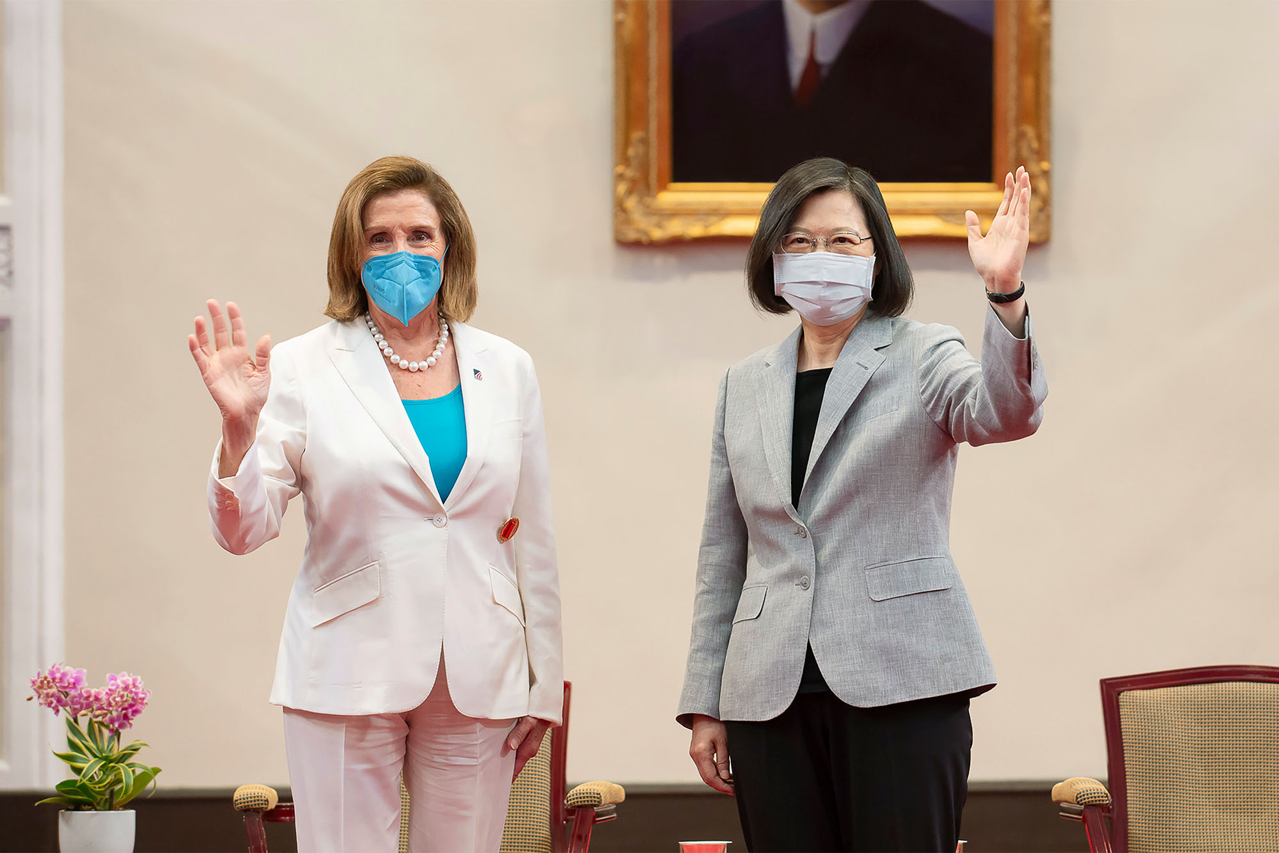
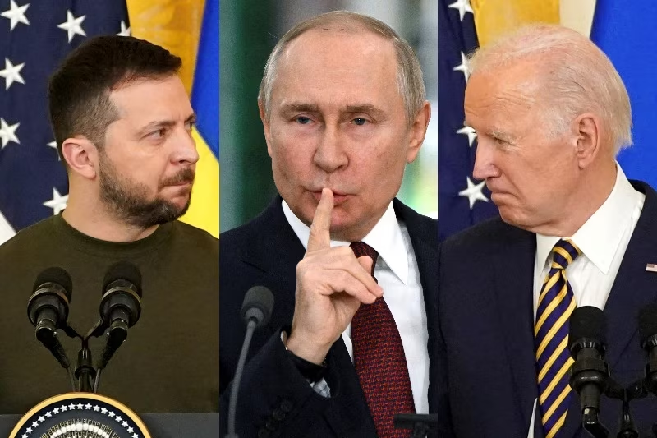












Project Background
A lot of events happened in 2022, especially:
Geopolitical Entities (GPE): USA, China, Taiwan, Russia and Ukraine
Media Attitudes at the end of 2022?
NLP -> Sentiment Analysis

Slide 3

Related Work
Sentiment Analysis -> Classification
Naive Bayes
BERT -> a Pre-trained Transformer model
4. LIWC - 22
Linguistic Inquiry and Word Count (LIWC) is the gold standard in software for analyzing word use.

Slide 4
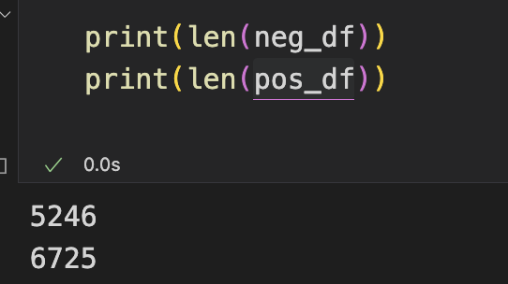
Database Selection & Web Crawling
[Training, Validation, Testing] Sentiment 140 -> 1.6 million annotated tweet data with sentiment
[Analysis] Web crawling using Twitter API (5 * 12 = 60 csv files with tweets)
based on the 12 Media twitter accounts + 2022.12.1 to 2022.12.31 + EN
–> Remove Links, @， #, (stopwords when using NaiveBayes model)
LIWC
Topic Analysis: Politics <- Psycholinguistics features
5000 Negative data
5000 Positive data

Slide 5
Data Preparation
10000 balanced labeled data
Divide into 9:1 Training(validation) vs. Testing
Training [7200]
Validation [1800]
Testing[1000]
5-fold validation
“Semi-supervised”

Slide 6
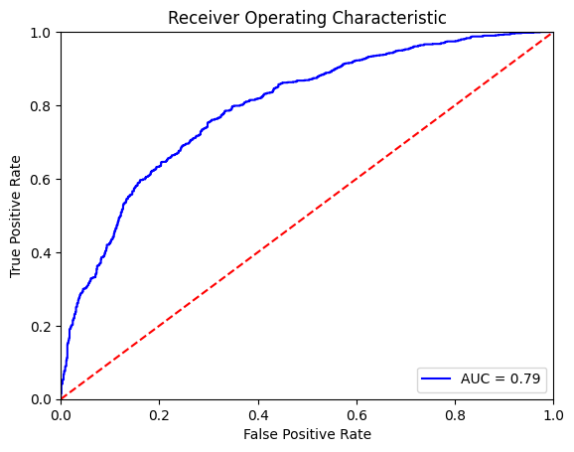
Baseline - Naive Bayes & TF-IDF
AUC: 0.7948
Accuracy: 71.72%

Slide 7
Transformer - BERT
Pre-trained
Fine-tuning
AdamW
Batch-size: 32
Learning rate: 1e-5
Epoch: 5

Slide 8
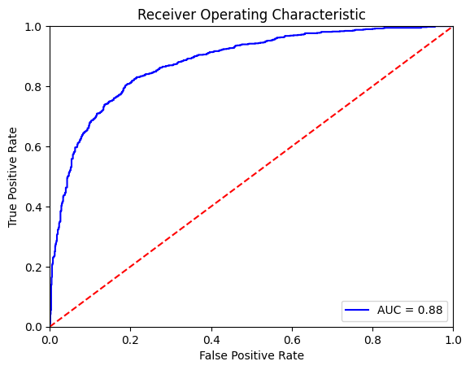
Performance on validation set
AUC: 0.8798
Accuracy: 80.61%

Slide 9
Testing
Number of tweets predicted non-negative: 466
Accuracy of non-negative out of 500: 0.932
Threshold: 0.8

Slide 10
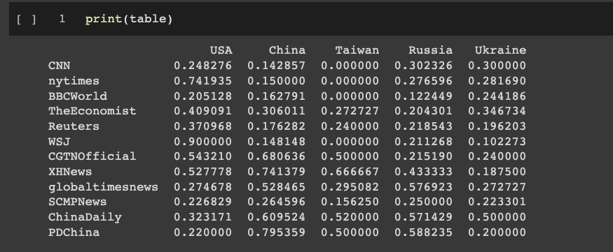
Prediction & Manual Annotation

Slide 11
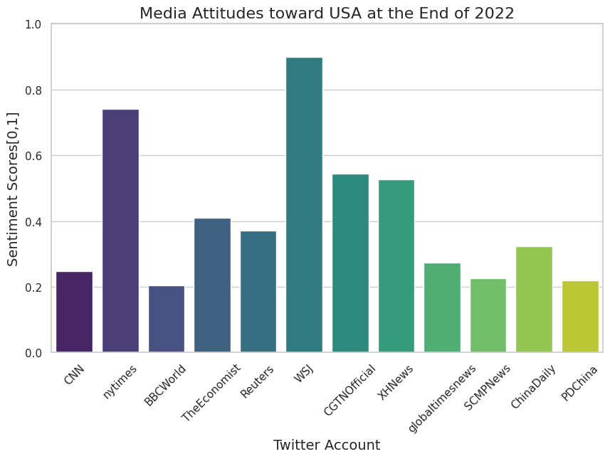


Slide 12

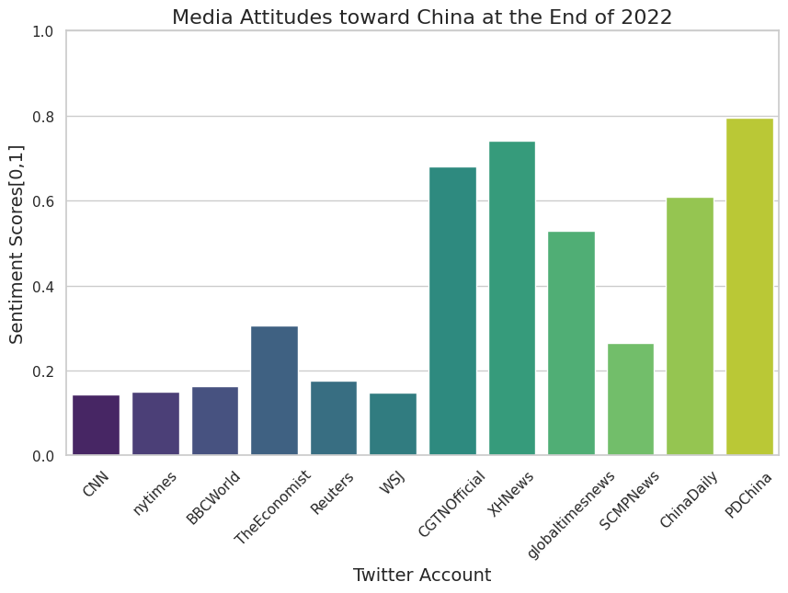

Slide 13

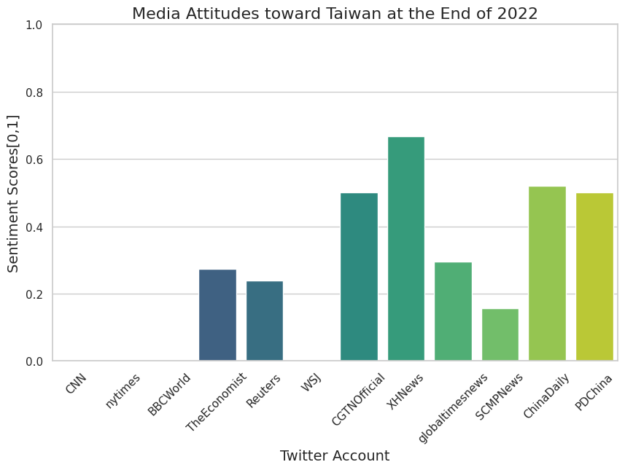

Slide 14

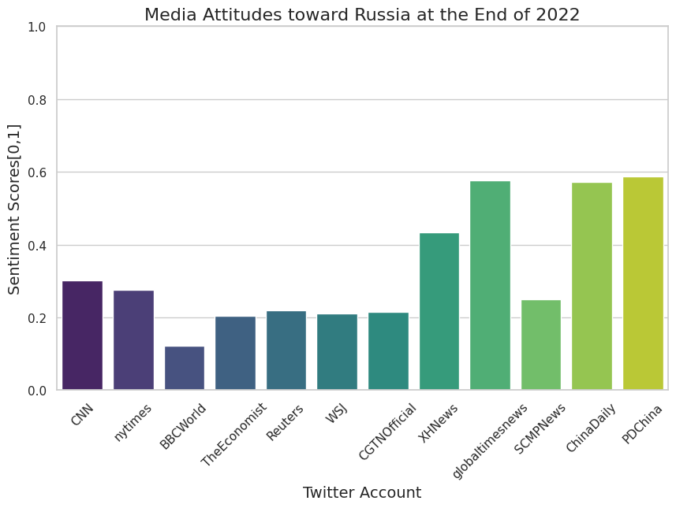

Slide 15
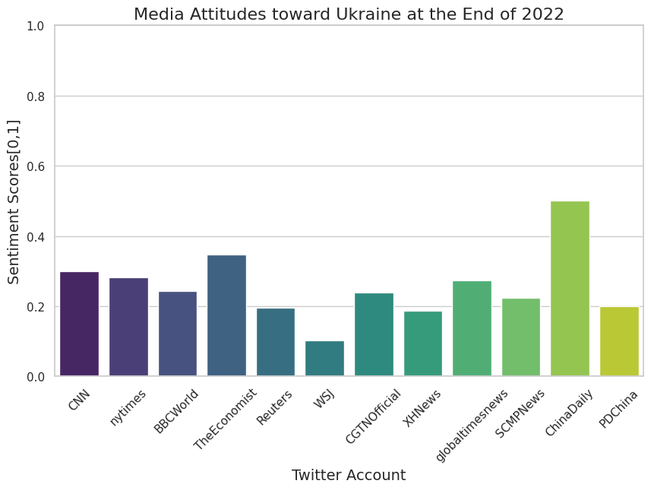


Slide 16
Q&A

